Slide 1

Evaluation: An Introduction to Improving or Judging
Do or Do Not. There is No Try.
Dr. Abhik R. Roy
EDP 611

Slide 2
Review!
What’s validity?
The degree to which the variable measures what it is intended to measure.
What’s reliability?
The extent to which the measurements remain consistent over repeated tests of the same subject under identical conditions.

Slide 3

Evaluation
The act or process of determining the merit, worth, or significance of something or the product of that process.

Slide 4

Evalu…
…ator (evaluator)
The person evaluating something.
Asks things like: What are the values of people in the program? What are the terms and conditions of a study?...and more!
…ate (evaluate)
The act of evaluating something.
Asks: Does it work and why does it (or doesn’t it) work?
…and (evaluand)
The thing being evaluated.
Asks things like: Where are the boundaries of a particular program? Do the evaluator, their employer, and various other stakeholders agree on those boundaries?...and more!

Slide 5
Criteria, Standard, and Indicator
What do you think these are?
Which of the three is harder to identify? Why?

Slide 6
Criteria
The aspects, qualities, or dimensions that distinguish a more meritorious or valuable evaluand from one that is less meritorious or valuable evaluand.
In program evaluation, a program has merit if
it does what is sets out to do (e.g., achieves its intended outcomes) AND
it makes a meaningful differences as a consequence to its operation.
Example: A car may have merit if it meets these criteria: it is reliable, safe, good fuel consumption, and powerful.

Slide 7
Standard
The levels of performance, expressed as a rating or grade on a given criterion.
Examples:
Often expressed as a cut score (quantitative): You need a minimum of a 2.8 GPA to get into a graduate program.
May be qualitative: such as an exemplar of acceptable performance: You performed well in your thesis defense.

Slide 8
Indicator
It is the operationalization of the variables used in an evaluation. In layman’s terms, it is basically the what can be measured within an evaluand.
Example: The score on the Stanford-Binet test is an indicator of the IQ as a variable.
Notice that validity and reliability are not necessarily tied to the concept.

Slide 9

Merit, Worth & Significance
What do these mean to you?
merit?
worth?
significance?
Can you provide real world examples of each?

Slide 10
Merit
Generally: The absolute or relative quality of something, either overall or in regard to a particular criterion.
Evaluation Context:
Officially:
Quality or excellence of an evaluand absent of cost and context.
An intrinsic value
Unofficially:
Does an evaluand do well what it is supposed to do?
An issue of Quality

Slide 11
Merit Example
Evaluation Question: Does the WVU Department of Counseling, Rehabilitation Counseling, and Counseling Psychology Ph.D. in Counseling Psychology program succeed in producing Health Service Psychologists who are ready for entry-level clinical and academic practice in the area of Counseling Psychology?
If so, it probably has merit.

Slide 12
Worth
Generally: A measurement of value associated with criteria, standards. and/or indicators.
Evaluation Context:
Officially:
Measure of merit under construction and cost.
An extrinsic value
Unofficially:
What is the value of an evaluand?
An issue of Value

Slide 13
Worth Example
Evaluation Question: Do graduates of the WVU Department of Counseling, Rehabilitation Counseling, and Counseling Psychology Ph.D. in Counseling Psychology program perform equally or better than counterparts across the country?
If so, it probably has worth.

Slide 14
Significance
Generally: A state or conclusion of quality and value.
Evaluation Context:
Officially:
Merit and worth under a specific context.
An assessment of intrinsic and extrinsic values in a particular setting.
Unofficially:
What is the value and meaning that one assigns to an evaluand?
An issue of Importance

Slide 15
Significance Example
Evaluation Question: Is the WVU Department of Counseling, Rehabilitation Counseling, and Counseling Psychology Ph.D. in Counseling Psychology program necessary for the sustainability of qualified counseling psychologists in the United States?
If so, it is probably significant.

Slide 16
Caveat
Most evaluation questions are not polar.
They often include elements of merit, worth and significance.
Not even the examples were really polar.

Slide 17
So evaluation is…
Based on values.
Not well defined (and should not be since you’re dealing with people!)
Erratic.

Slide 18
Evaluation
The act or process of determining the merit (quality), worth (value), or significance (importance) of something or the product of that process.
Addresses values!

Slide 19
Formative
Conducted with the intent to improve
Summative
Conducted with the intent to inform decision making and/or determine judgement
Purposes of Evaluation – Primary

Slide 20
Purposes of Evaluation – Secondary
Developing To help develop an intervention or program.
Accountability
To hold accountable
Monitoring
To assess implementation and gauge progress toward a desired end
Knowledge Generation
To generate knowledge about general patterns of effectiveness
Ascription
Merely for the sake of knowing.

Slide 21
Purposes of Evaluation Activity
Monongalia County has decided to provide employ training and development opportunities to all publicly funded counselors county-wide. The county executive forms a committee called the Counseling Staff Development Committee (CSDC) to develop a program for all counselors in the county.
 | What might the purpose of the evaluation be? | What questions might the evaluation try to answer?
Formative Evaluation The program has been designed and piloted with a group of 20 publicly funded counselors. What kind of evaluative feedback should the CSDC seek?
Summative Evaluation The program has been delivered to all counselors in the county. What kind of evaluative feedback should the CSDC seek?

Slide 22
Introduction to Roles and Styles
Define
Discuss
What are some benefits and drawbacks to each role?
How does role influence evaluation stance/practice?
Does it really matter?
Type of Evaluator | Role with evaluand
Independent | Evaluator separate from the content or context.
External | Evaluator from the outside.
Internal | Evaluator from the inside.
Topical | Evaluator also with content knowledge

Slide 23
Defining Culture
What is culture? How do we recognize it?
“Culture can be defined as the shared experiences of people, including their languages, values, customs, beliefs, and more. It also includes worldviews, ways of knowing, and ways of communicating. Culturally significant factors encompass, but are not limited to, race/ethnicity, religion, social class, language, disability, sexual orientation, age, and gender.”
(AEA, 2011)

Slide 24
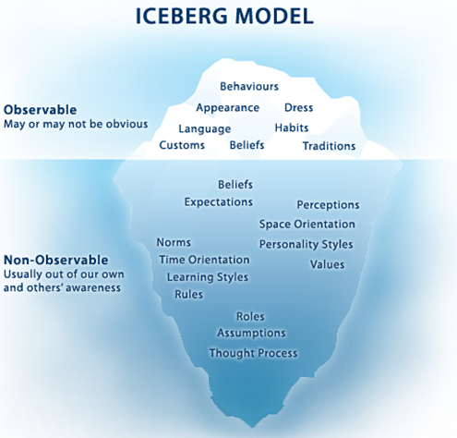

Slide 25
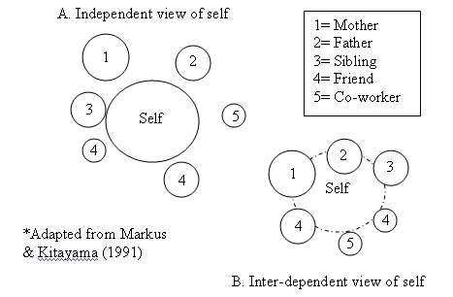
Markus & Kitayama (1991)

Slide 26
Cultural Influences Activity
How might each of the following influence an evaluation’s design and implementation?
Language of participants
Role of food and eating
Evaluators attire when interacting with participants
Concept of time
Communication styles
Importance of family relationships
Values/norms re: individualism, independence, conflict
Understanding of social structure

Slide 27
Meta-evaluation
Formally
Extra, external study to authenticate the process or product of the evaluation.
Informally
Evaluating an evaluation or evaluations.

Slide 28
You will like evaluation work if you
thrive in uncertainty.
are able to communicate high level ideas and findings with people in a low level mode.
like field work.
have the ability to work 60 hour weeks and then nothing.
can negotiate!

Slide 29
Situation
You are tasked with evaluating a sustainable food program in rural villages within within Albania, Nepal, and Uganda.
Locations and Synopsis: In each situation, After a surplus is assessed, they are then to pass it along to another family repeating the same process.
Albania – Honey bees are given to one family for honey.
Nepal – Cows are given to one family for milk.
Uganda – Goats are given to one family for meat.
The sponsoring organization, Heifer International, wishes to know which program has the greatest likelihood of sustainability.
You have enough funding to study these three years.

Slide 30
Evaluation task
Construct evaluation questions to study the phenomena.
How would you proceed in a cultural sense?
Describe how you would study the growth or decay.
List what contingency situations could occur and how you would deal with them.

Slide 31
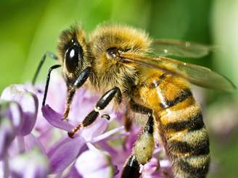
Most sustainable

Slide 32
Ok!
Now let’s take a 15 minute break!

